Slide 1
PHOTO
JOURNAL
SITE
(mini-project)

Slide 2
INDEX
Introduction
Project Details
Abstract
Aim of The Project/Technical Feasibility
Project Plan Methodology
Study of Existing System
Database
Snapshots

Slide 3
INTRODUCTION
The system allows user to share their best photos.
It provides the user to ﬁnd out there category photos to get knowledge and idea how others photographer clicks.
In this website the user can share their idea and knowledge of photography by uploading pics with their customized captions .
This website is web-based application, so all people of world can access it from any where any time .

Slide 4
PROJECT DETAILS
Project Title :- Picturesque.com
Platform :- any platform
Back-end (Used) :- MySQLi, PHP
Front-end (Used) :- PHP, HTML, CSS
Web Server :- Apache Server .
Development Tools :- Adobe Photoshop CS6.

Slide 5
ABSTRACT
Photography Journal (picturesque.com) website is only for photographers  This Website provide a platform for beginners or professional photographer to share their photos in this website.
It provides Online Registration for the users.
These website updates the recent post every time any user uploads the picture .
To make this website work successfully we have used some latest technology such as, PHP framework as the development ,MYSQLi as the Database Management environment and HTML5 as structural.

Slide 6
AIM OF THE PROJECT/
TECHNICAL FEASIBILITY
System will help to those photographer who are pro or beginners.
System is handle by Technical or Non Technical Visitor Website .
This system will help pro or beginners photographer get known.
Quick to Fast Response

Slide 7
PROJECT PLAN METHODOLOGY
Problem is to ﬁnd the ideas, tips and tricks for the beginners .
Problem to share the photography skills to the professional world.
Problem is to get platform for beginners and professional .
Problem is to ﬁnd out best category photos

Slide 8
STUDY OF EXISTING SYSTEM
There are very less websites which provide the true platform for the photographers.
Most of the website are work like as a normal social media.
There are some website really for photographers but they are only for speciﬁc brand or community.
There is a feature which helps the user to display any name the want under their uploaded picture for privacy purposes.

Slide 9
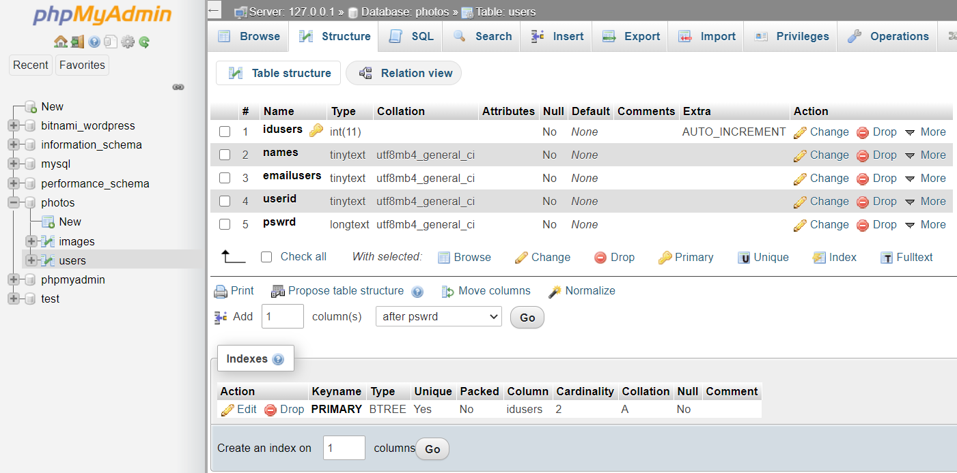
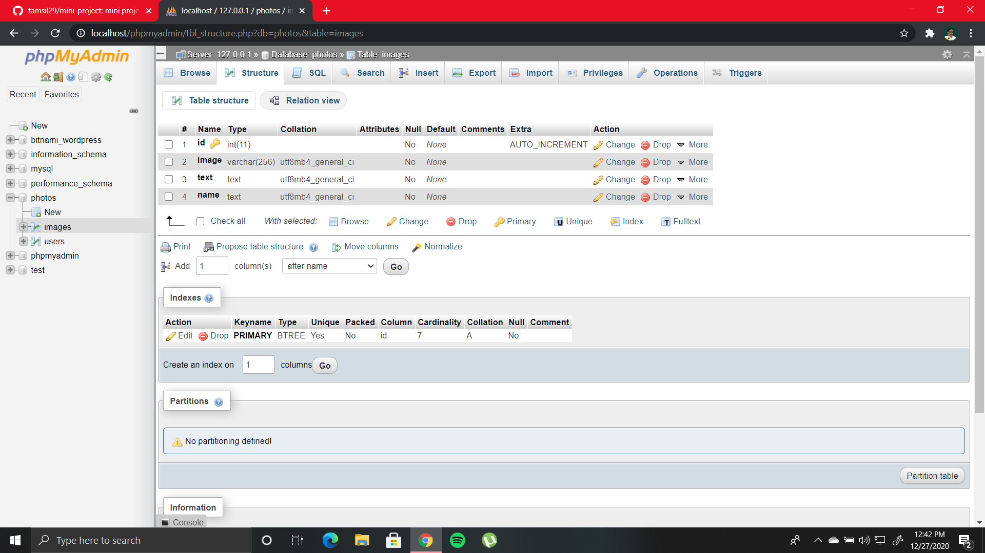
DATABASE(user-id/passwords)

Slide 10
DATABASE(images/captions)

Slide 11
MAIN MODULE
Home(with recent posts)
Sign up
Registration
Sign in
Upload pics
Go to home to see your upload
Sign out

Slide 12
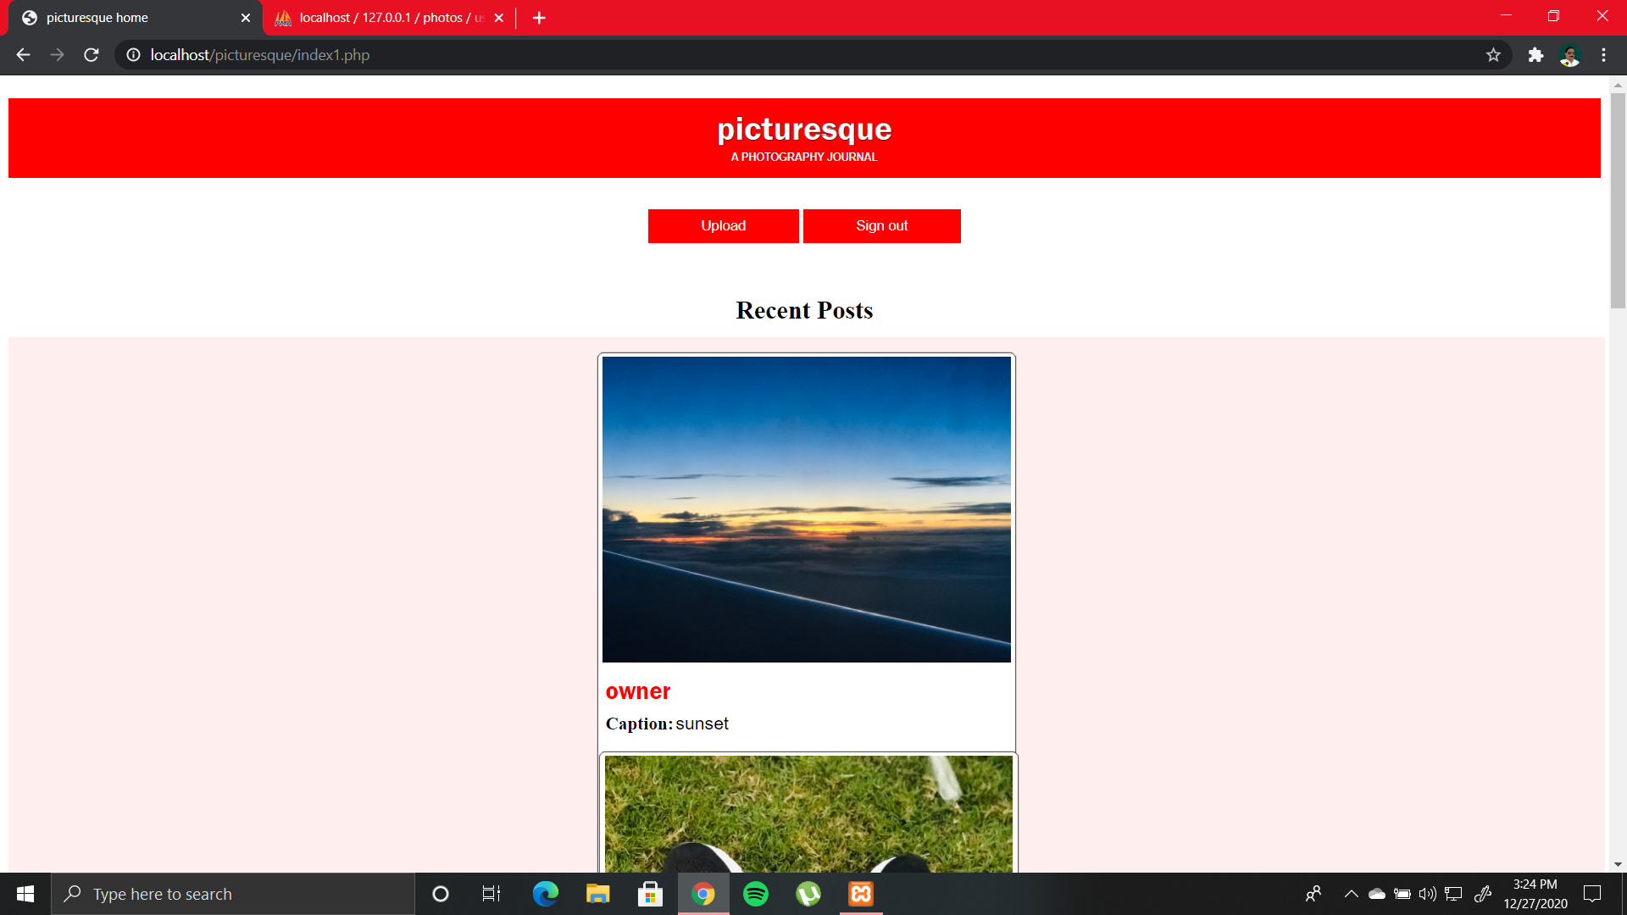
HOME PAGE

Slide 13
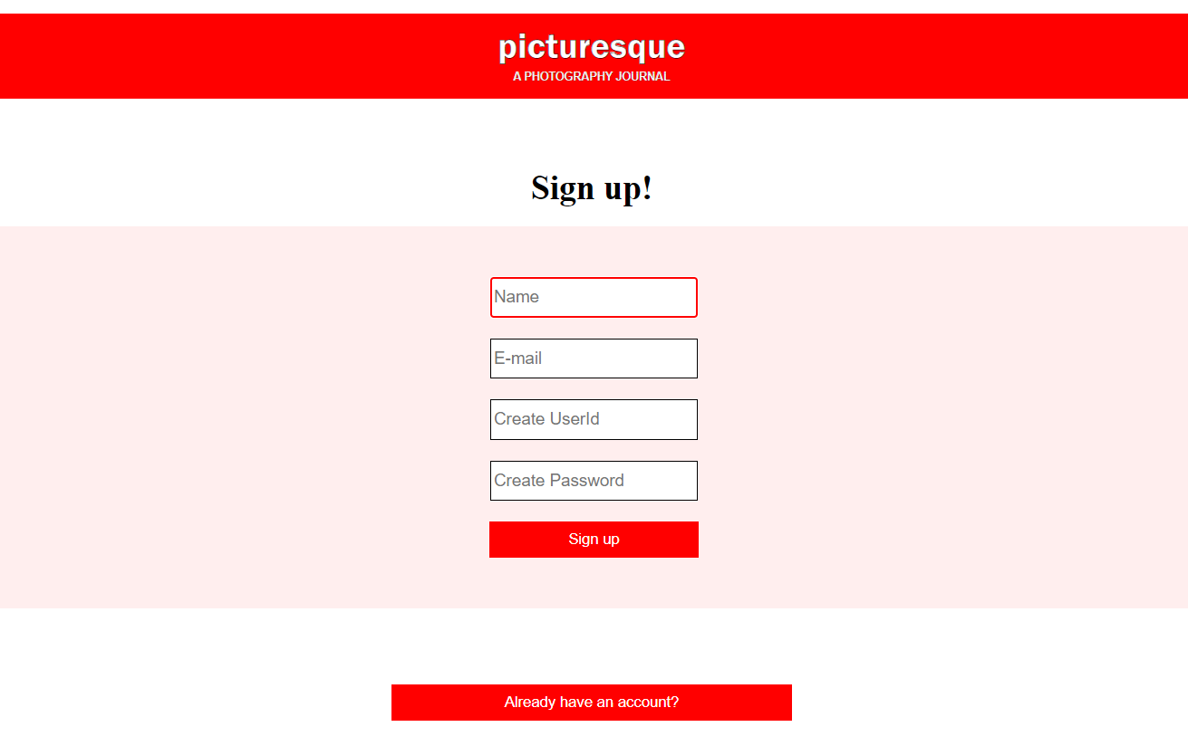
SIGN UP / REGISTRATION

Slide 14
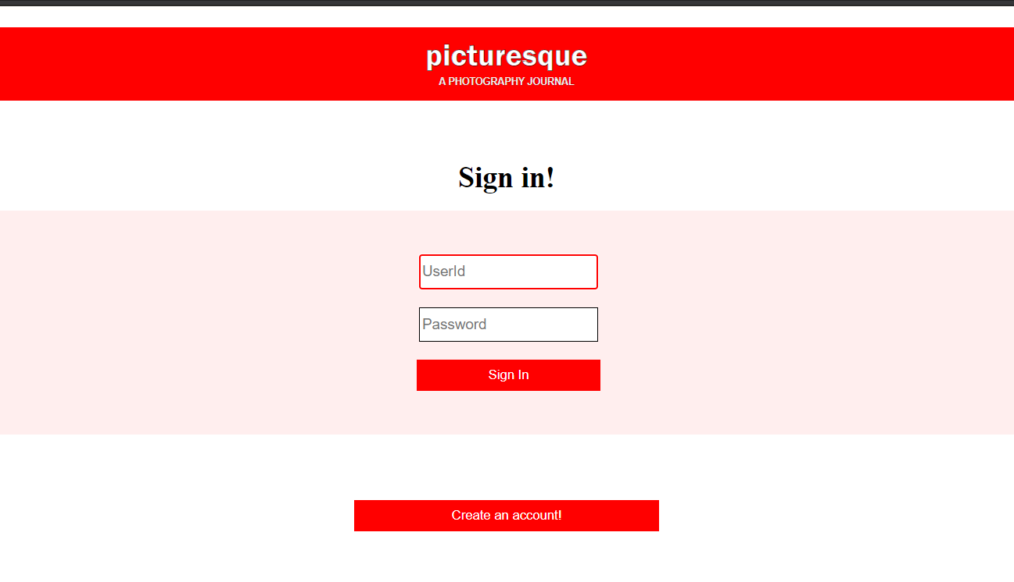
LOGIN PAGE

Slide 15
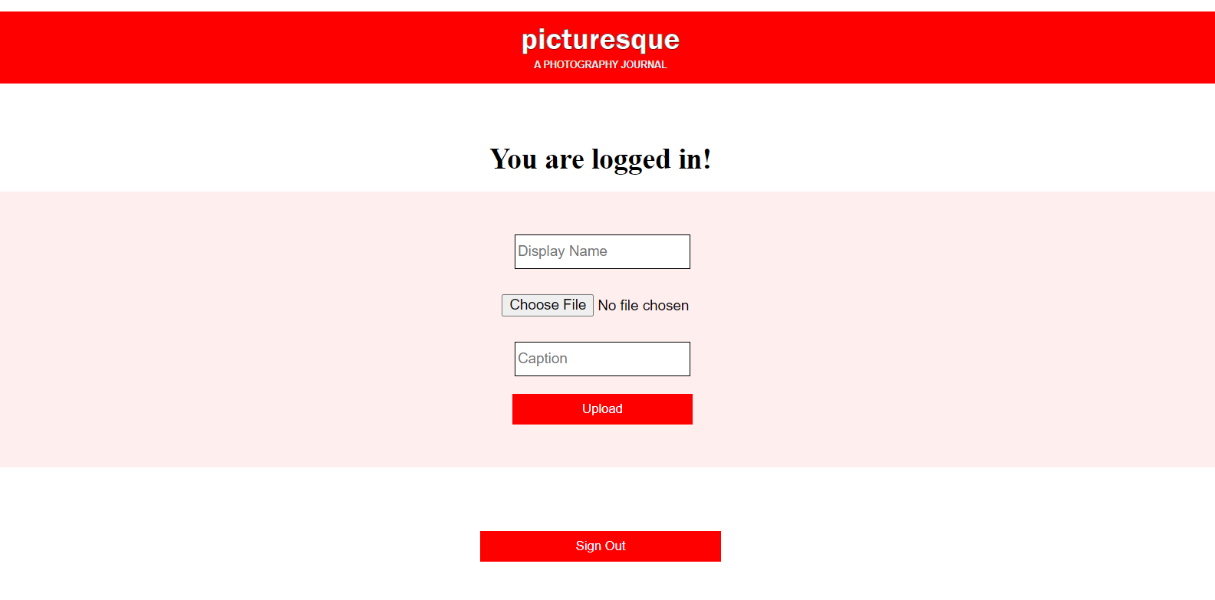
UPLOADING PAGE

Slide 16
THANK YOU
A Presentation By
Hritik Arora
Mohd Tamsil
Mayank Kumar

